Slide 1
Occupancy Management System
ID620, Project 01
Ike Callaghan

Slide 2
Scope
Develop a functioning occupancy management system to automate the process of seating customers.
Detect customers with PIR sensors.

Slide 3
What is it for?
This system was designed to automate a small process for any venue or business.
Keeps track of current occupancy.
Reduces workload of staff.
Allows customers to know if venue is full.
Allows customers to seat themselves without waiting for staff.

Slide 4
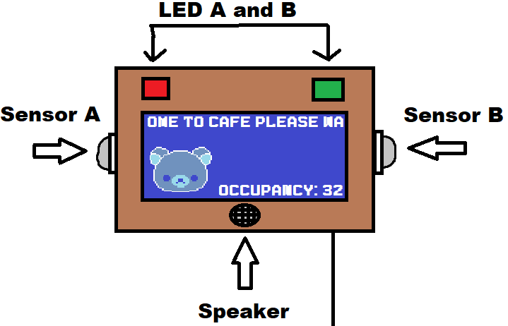
Initial Prototype / Concept

Slide 5
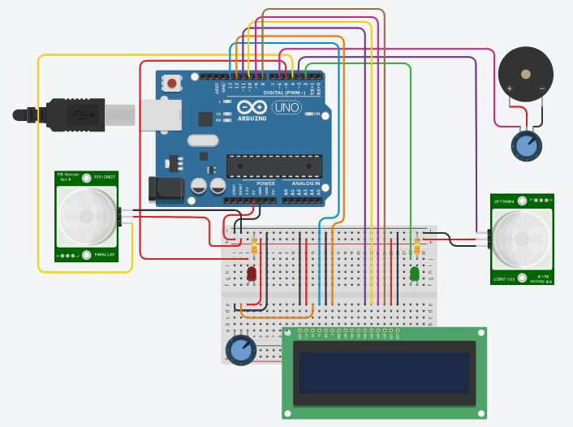
Circuit Diagram
16x02 LCD Display
Piezo Speaker (Inbuilt potentiometer)
Potentiometer
2* LEDs (Green, Red)
2* PIR Sensors
2* 330Ω Resistors
9* MtF Jumper Wires
16* Jumper Wires
Arduino Uno
Breadboard

Slide 6
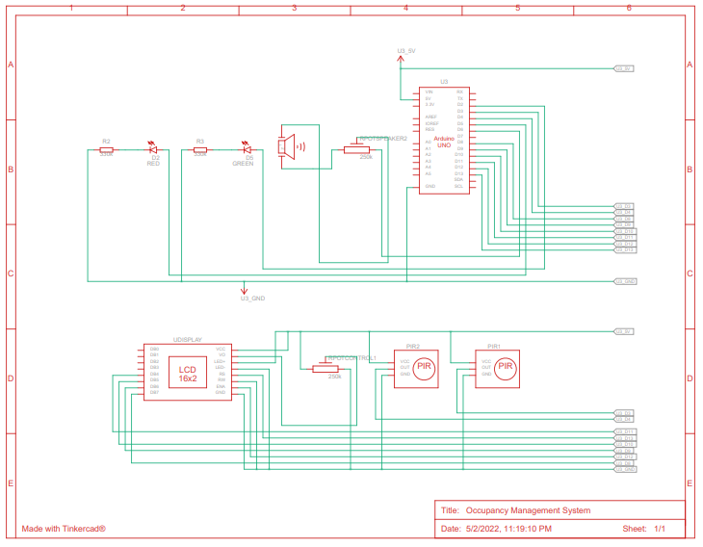

Slide 7
Functions
noSeatChime() entryChime() exitChime()
Contain sequences of frequencies for piezo to play depending on current occupancy.
textScroll()
Scroll through 80 characters of text (two rotations)
Start checking for detected motion on second rotation (characters 40-80)
checkSensors()
Checks if either sensor detects motion.
If motion is detected, perform an action depending on the current occupancy.

Slide 8
Functions cont.
characterAnimation()
Plays a character animation after a full text scroll cycle
Uses delay() and lcd.clear() to animate.
Sensors are checked every frame (200ms)
availableSeatsFunction()
Changes the text output depending on occupancy.
More than 1 available seat = “There are X seats available.”
1 available seat = “There is X seat available.”
0 available seats = “There are no seats available.”

Slide 9
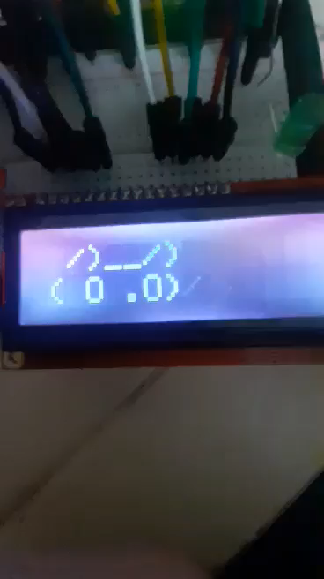
Animation Preview

Slide 10
Issues / Constraints
Bulky and lots of components: more suited to a purpose-built PCB.
Use shorter cables, smaller breadboard.
Prototyping case is terrible.
3D print case
Not enough digital pins on Arduino Uno.
Spent a lot of time figuring out how PIR sensors work.
Duinotech documentation was difficult to understand for a beginner
Piezo speakers are a bit grating.
Larger speaker that reads audio files off SD card.
Would require more than 5V

Slide 11
Issues / Constraints cont.
Does not account for detection of groups or staff.
A fully functioning solution would require computer vision.
Staff still have to check for waiting customers.
Only detects motion every 200ms due to character animation.
Remove character animation.
LCD display is too small / inaccessible.
Cannot display more than 40 characters on each line.
Difficult to read/notice, especially for visually impaired.
Bad code practice
Main loop just contains a function call, not sure if bad practice.
A few formatting issues due time constraints.

